Slide 1
Modeling User Behavior for Vertical Search: Images, Apps and Products
SIGIR 2020 Tutorial
Xiaohui Xie, Jiaxin Mao and Yiqun Liu, Tsinghua University, China
Maarten de Rijke, University of Amsterdam & Ahold Delhaize, The Netherlands

Slide 2

Who we are
Xiaohui Xie, Ph.D. student at DCST, Tsinghua University
Research interests: Multimedia search, User behavior modeling and Artificial intelligence
Website: https://thuxiexiaohui.github.io/
Jiaxin Mao, Postdoctoral researcher at DCST, Tsinghua University
Research interests: Information Retrieval, Web Search, and Applied Machine Learning
Website: https://sites.google.com/site/maojiaxin/

Slide 3
Who we are
Yiqun Liu, Professor and Department co-Chair at DCST, Tsinghua University
Research interests: Web Search, User Behavior Analysis, and Natural Language Processing.
Website: http://www.thuir.cn/group/~YQLiu/
Maarten de Rijke, Professor at the University of Amsterdam, Vice President Personalization and Relevance at Ahold Delhaize
Research interests: search, recommender systems, and conversational search
Website: https://staff.fnwi.uva.nl/m.derijke/

Slide 4
Outline
Background and objectives
User behavior data collection
Analytical results of user behavior data
User-centric evaluation metrics
User-centric ranking models
Conclusion and future directions

Slide 5
Background and objectives
Yiqun Liu

Slide 6
Motivation
Vertical search refers to search on a specific topic area or a specific segment of an overall search.
Vertical search has helped search engine users to efficiently obtain information in various forms
We focus on three types of vertical search services, i.e. Image, App and Product searches
Image
Product
Application
https://en.ryte.com/wiki/Vertical_Search

Slide 7
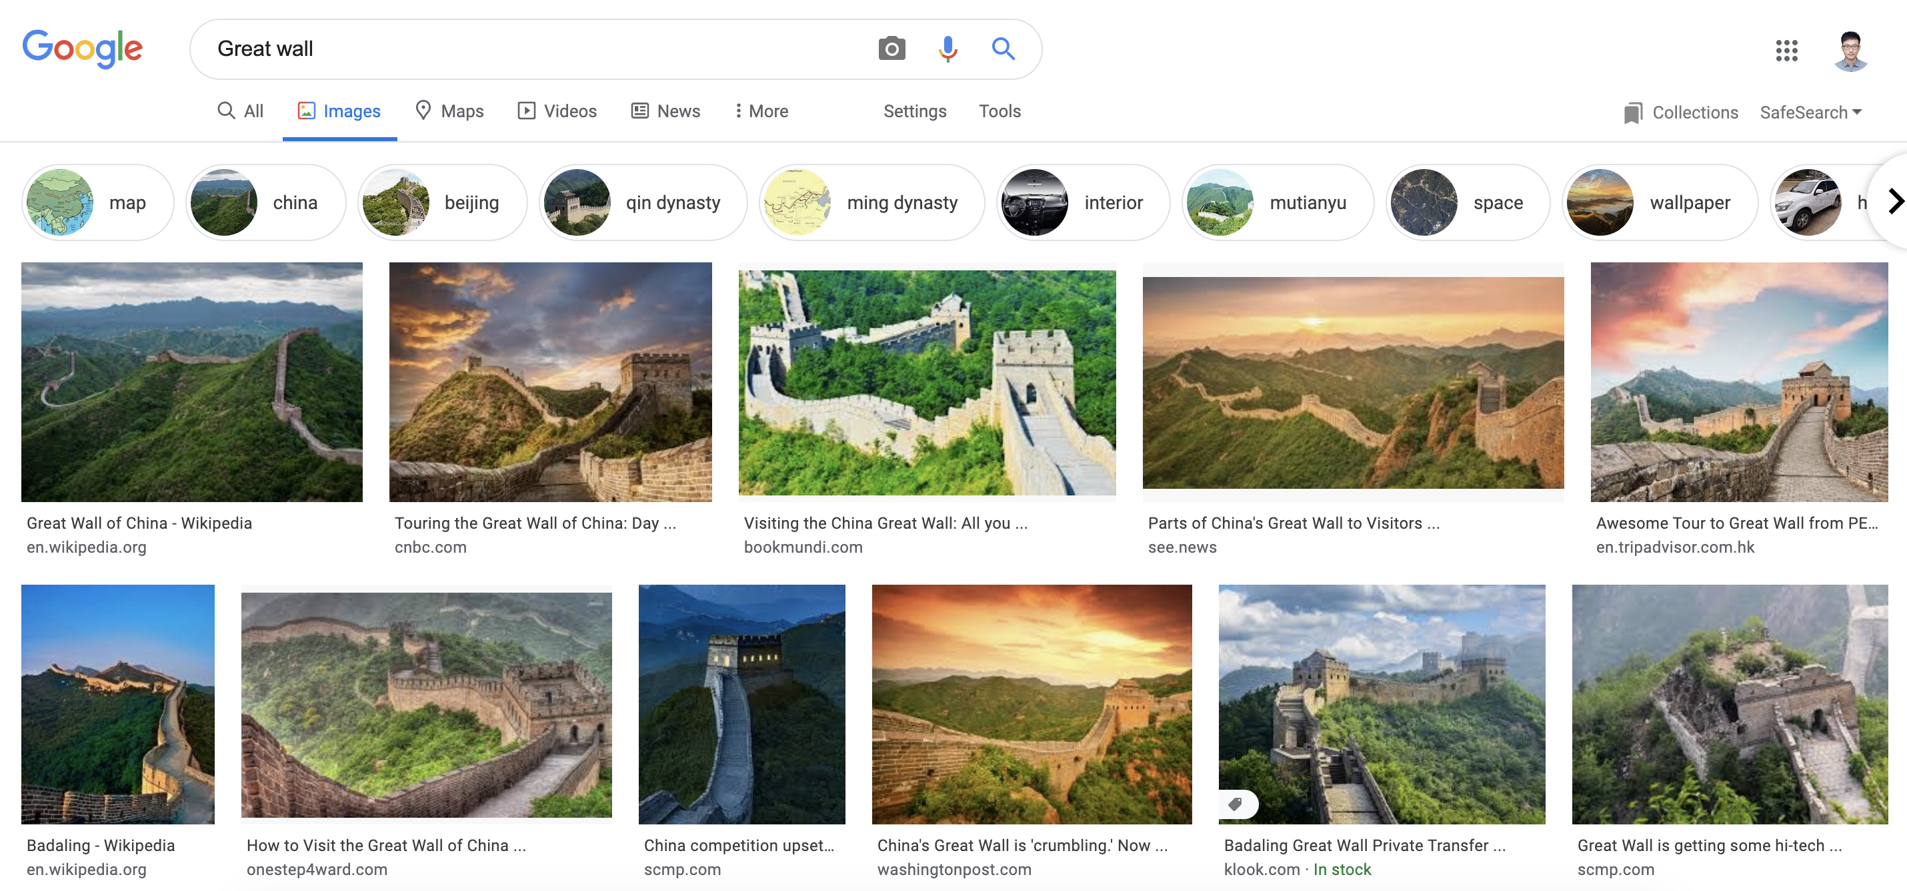
Motivation
Image
Image search
Queries showing image intent were second only to the navigational intent queries on desktops and tablets, and they were the most popular (42%) for mobile phone devices
Yong song et al. “Exploring and Exploiting User Search Behavior on Mobile and Tablet Devices to Improve Search Relevance” WWW 2013

Slide 8
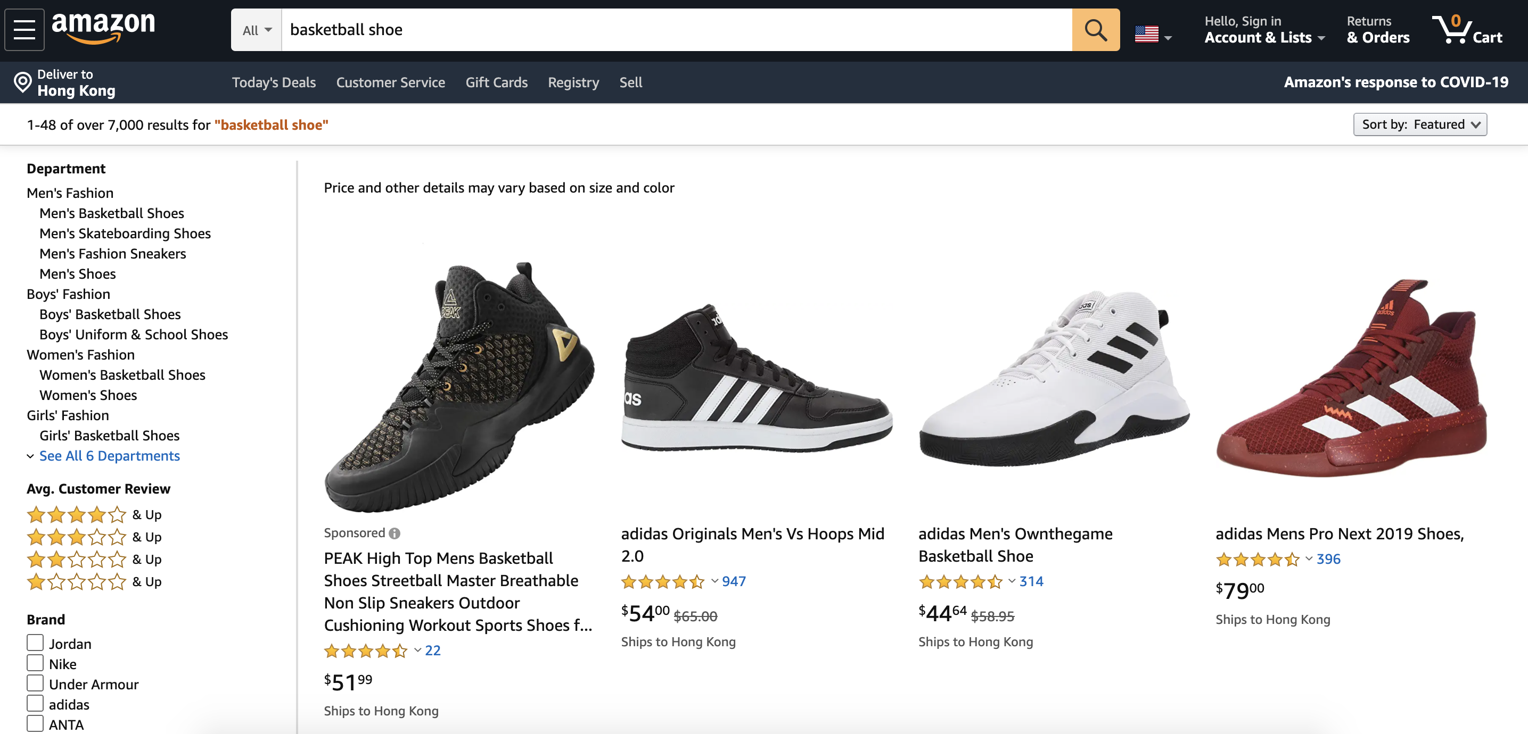
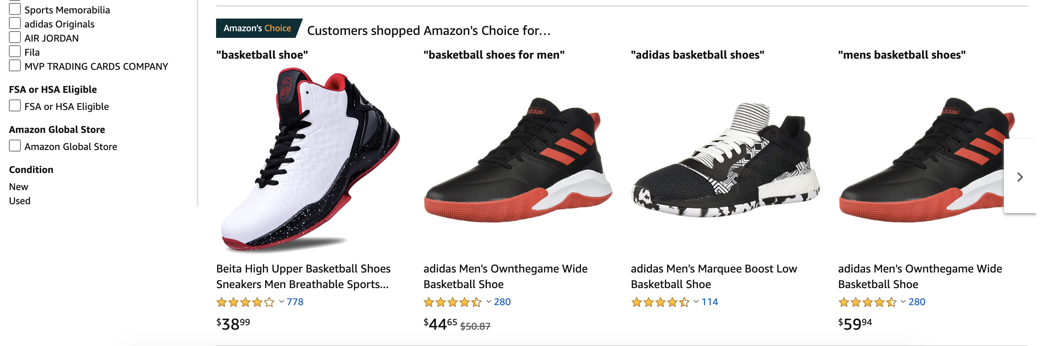
Motivation
Product
Product search
More than 55% of online product searches start directly on Amazon, compared to 28% that begin on a traditional search engine like Google or Bing.
https://www.bloomberg.com/news/articles/2016-09-27/more-than-50-of-shoppers-turn-first-to-amazon-in-product-search

Slide 9
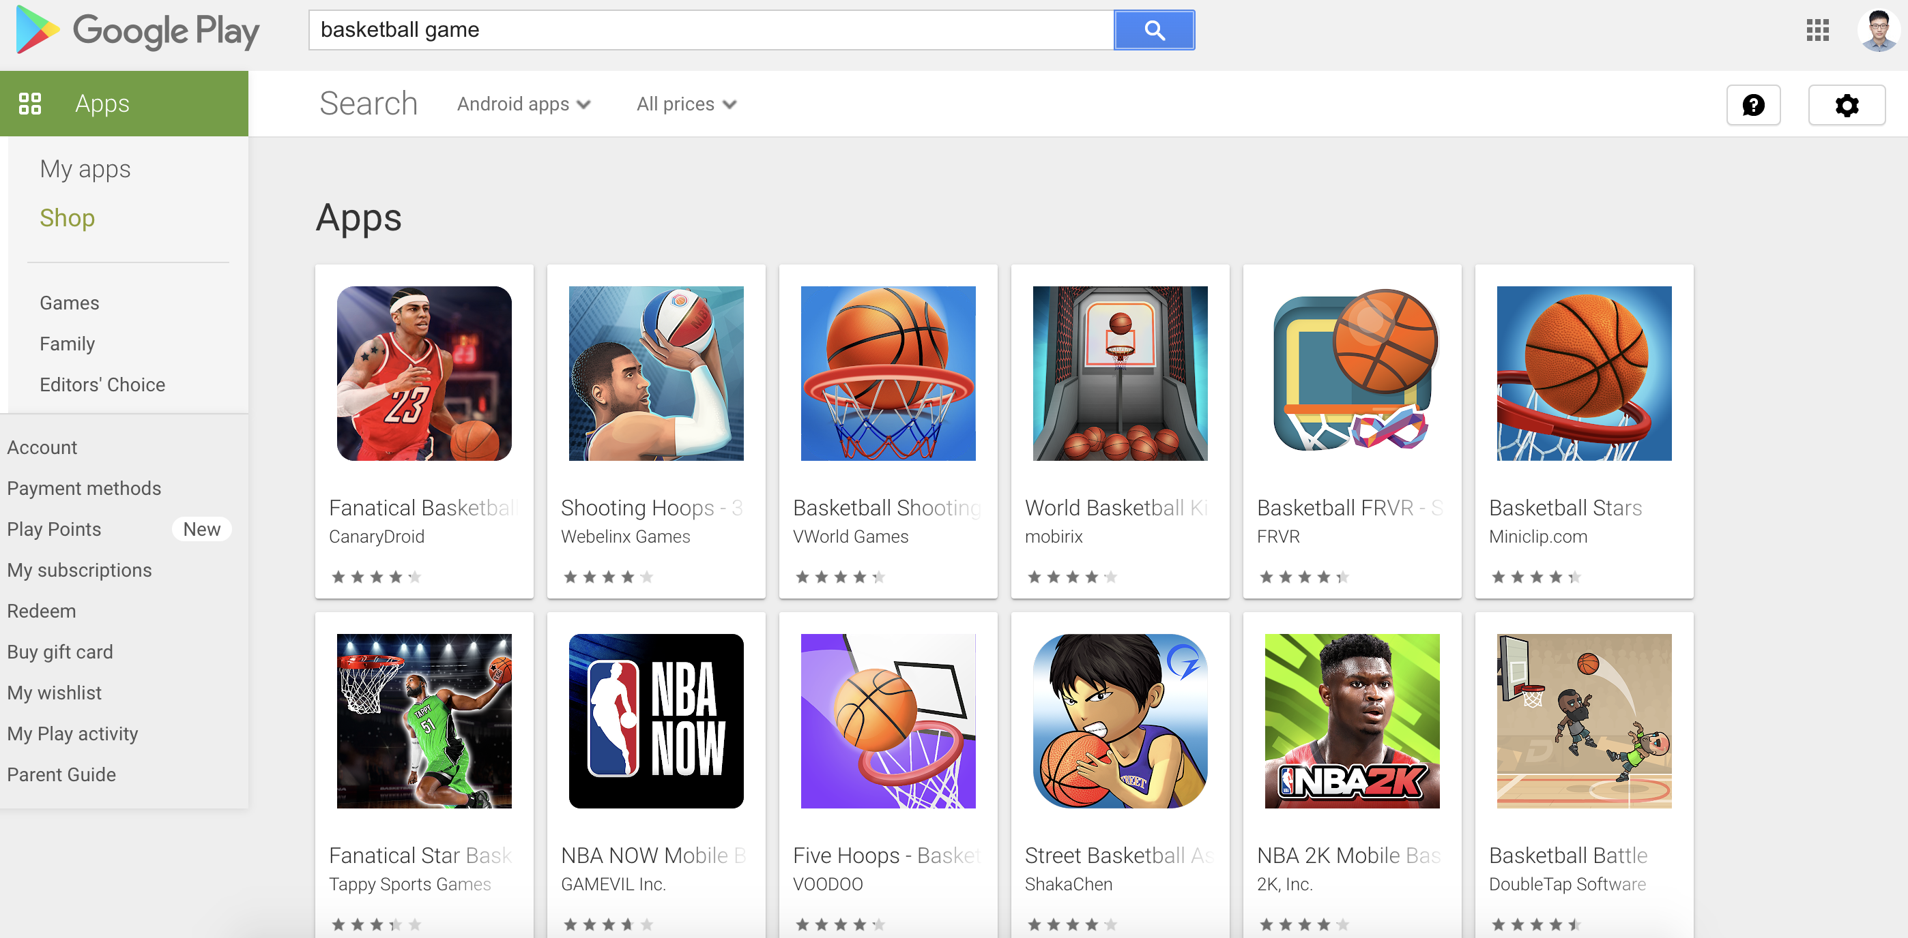
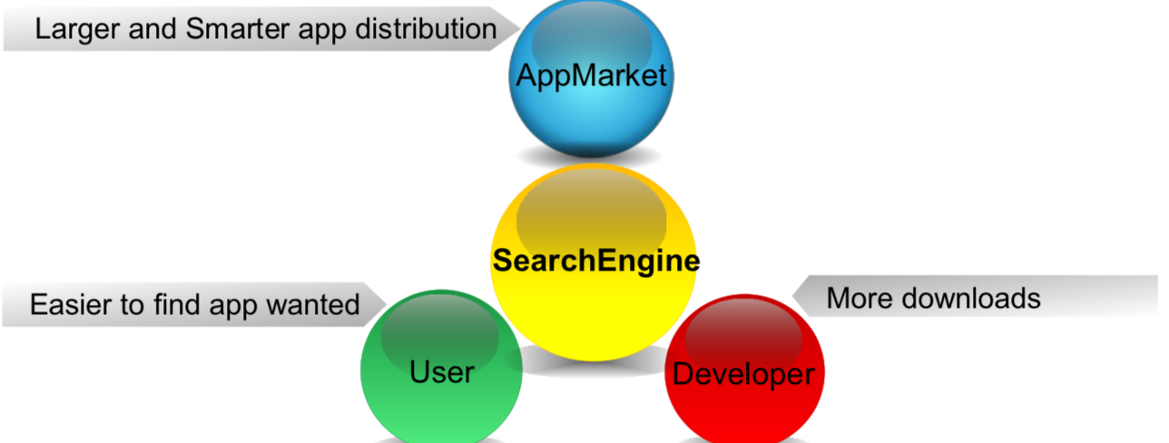
Motivation
Application
Application search
Objectives: Facilitate the app market, users and developers
Google Play Store now features more than 3.5 million apps and users install an average of 35 mobile apps on their phones, using half of them regularly
Juchao Zhuo et al. “Semantic matching in app search” WSDM 2015
https://www.thinkwithgoogle.com/advertising-channels/apps/app-marketing-trends-mobile-landscape/

Slide 10
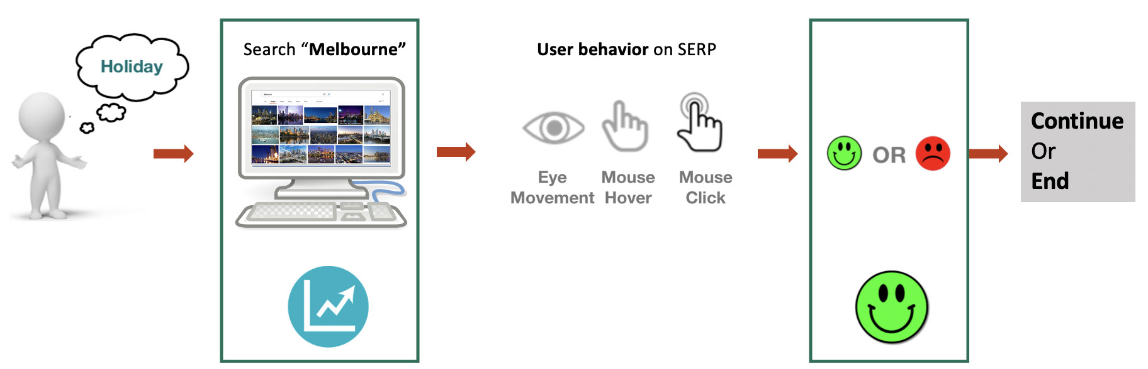
Motivation
User behavior data has been successfully adopted to improve general Web searches in result ranking, query suggestion, query auto completion
Understanding user interaction behavior in vertical search scenarios will also provide valuable insight into the optimization of their performances

Slide 11
Motivation
Vertical search engines differ from general web search engines
Affect
User behavior

Slide 12
Different search intents
Web search: Informational, Transactional and Navigational
Image search:
Explore/Learn, Entertain and Locate/Acquire
Knowledge orientation, Mental image, Navigation, and Transaction
Product search:
Target Finding (TF), Decision Making (DM) and Exploration (EP)
Shallow Exploration, Targeted Purchase, Major-Item Shopping, Minor-Item Shopping and Hard-Choice Shopping
Directed buying, Hedonic browsing, Search/deliberation, Knowledge building
App search: Precise search, Fuzzy search

Slide 13
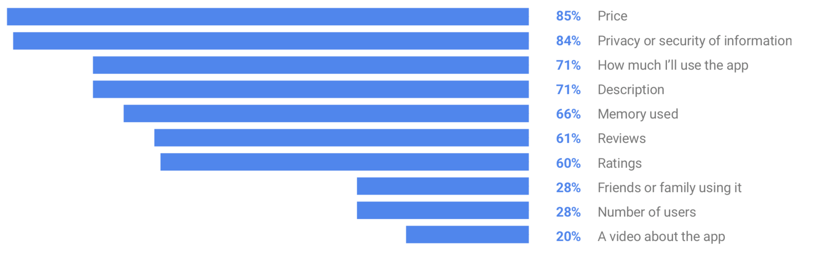
Different kinds of relevance definitions
More than topical relevance
Image search: Image quality and attractiveness
Product search: Availability, Price, Brand name, Ratings & User reviews, Latest model/version, Perceived value
App search: Price, Privacy or security of information, … (see below)
[1] Bo Geng et al. "The Role of Attractiveness in Web Image Search" MM 2011
[2] Omar Alonso et al. "Relevance Criteria for E-Commerce: A Crowdsourcing-based Experimental Analysis" SIGIR 2009
[3] https://www.thinkwithgoogle.com/advertising-channels/apps/app-marketing-trends-mobile-landscape/

Slide 14
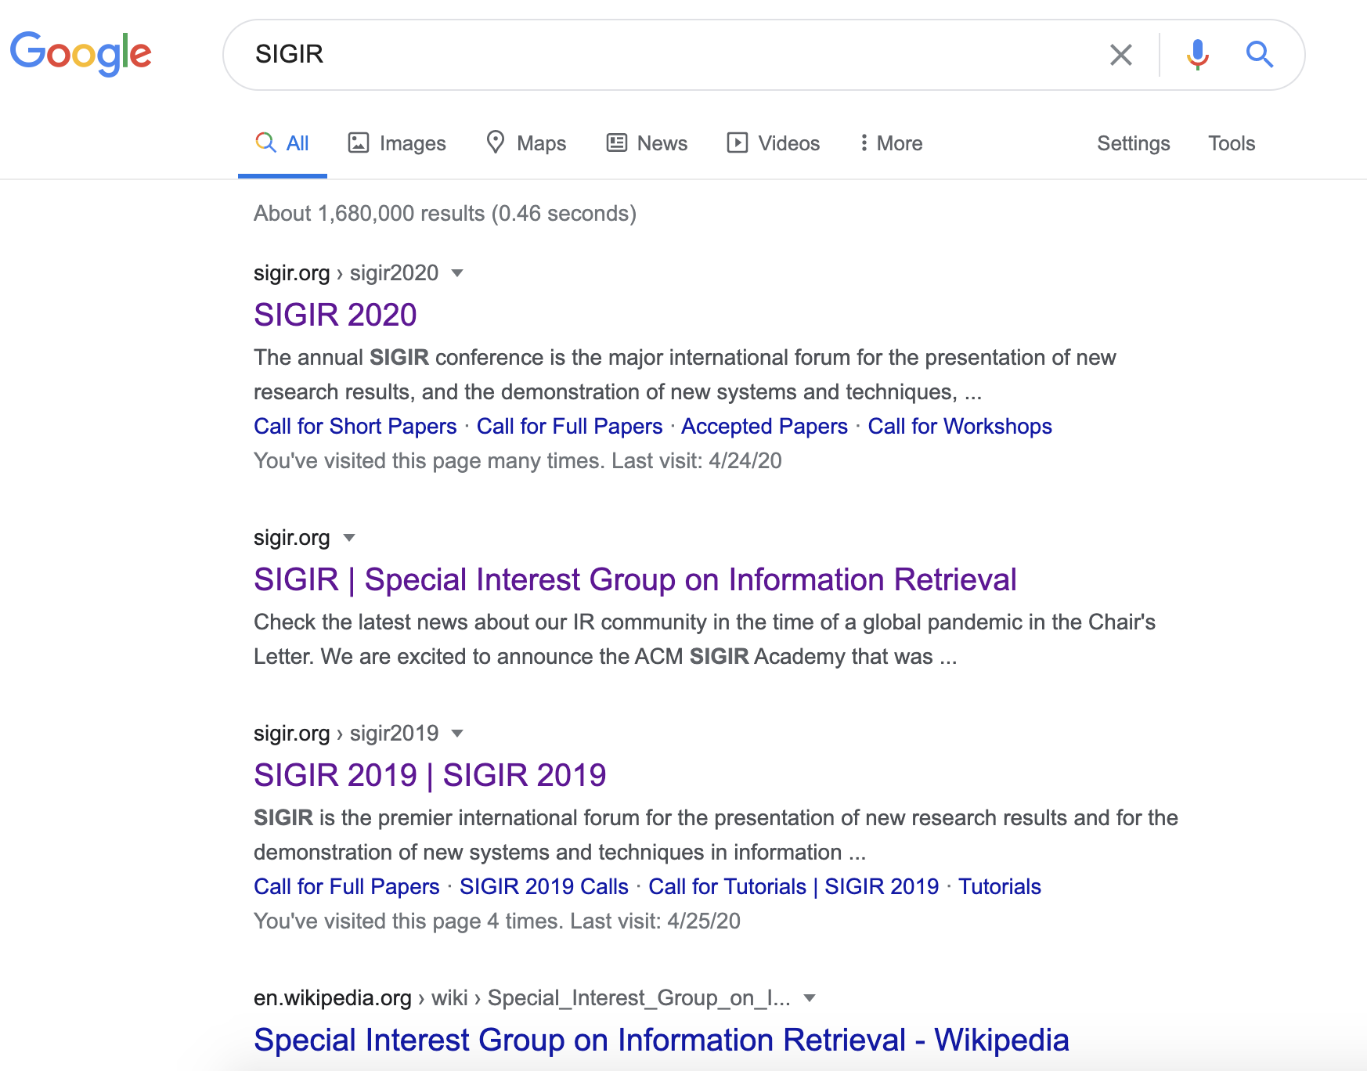
Different type of result placement
Grid-based panel (Vertical search) versus One-dimensional ranked list (Web search)

Slide 15
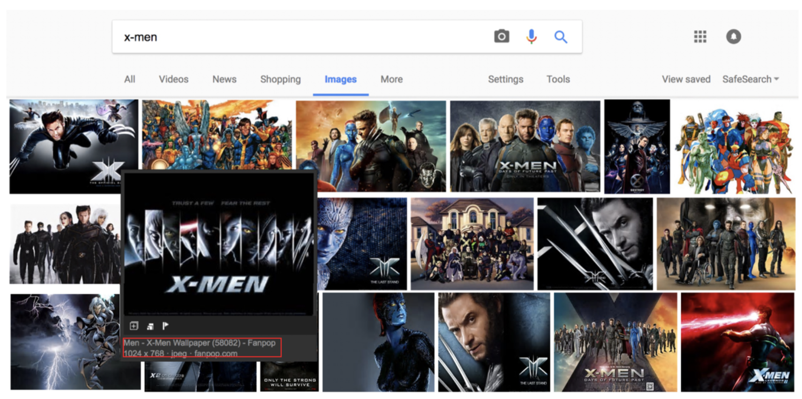
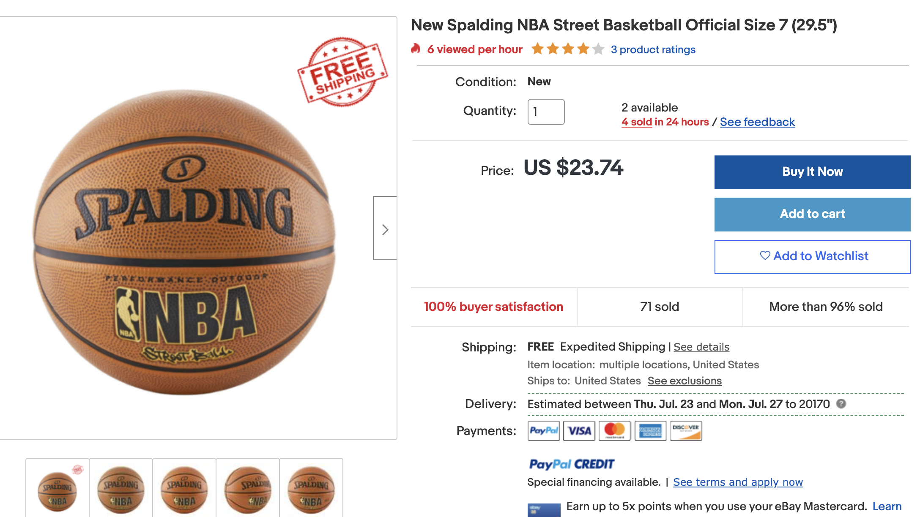
Different interaction mechanisms
Hovering/clicking on thumbnails to see meta info or preview pages
Pagination is usually not (explicitly) supported
Unique interactions : Add-to-carts, add to watchlist, purchase, review, download

Slide 16
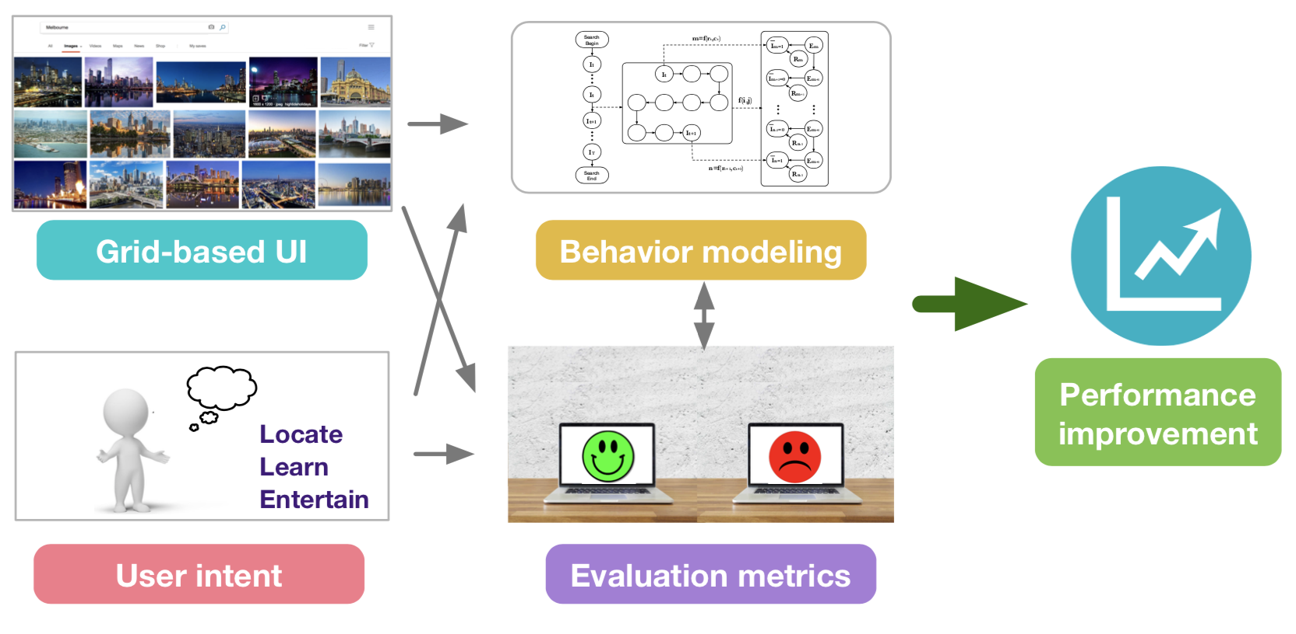
Motivations
User behavior modeling for vertical search has been investigated by different communities, in information retrieval, machine learning and cognitive science
A key aim of this tutorial is to bring these together and offer a unified perspective
Xiaohui Xie et al. “User behavior modeling for web image search”. WSDM 2019

Slide 17
Learning objectives
Learning objectives are organized around six challenges/research questions in vertical search scenarios that we will use as organizing principles
How does vertical search differ from web search ?
How to collect and study user behavior data ?
How do search intents, result placements and interaction mechanisms affect user behavior ?
How can we use behavior data to design better evaluation metrics ?
How can we use behavior data to construct better ranking models ?
What are future directions of research in user behavior modeling for vertical search ?

Slide 18
User behavior data collection
Jiaxin Mao

Slide 19
Collecting user behavior data
A brief overview of how to collect user behavior data for building user models
How user behavior data helps user modeling
Research approaches: lab study, crowdsourcing study, field study, log-based study
Data collecting methods: survey, interview, questionnaire, behavior logging, eye-tracking, annotation, and etc.
Something you should consider when collecting user behavior data
A short Q&A

Slide 20
Different types of user behavior models
“All models are wrong, but some are useful.”- George E.P. Box
Qualitative& conceptual models:
Qualitatively describing and characterizing user behavior in vertical search
Suggesting relationship between factors
Generating hypothesis and assumptions about user behavior

Slide 21
Different types of user behavior models
Quantitative & statistical models:
Quantitatively modeling user behavior
Measuring the correlation between factors
Testing behavioral hypotheses
Identifying the causal relationship between factors
Explaining the relationship between different factors

Slide 22
Different types of user behavior models
Predictive models:
Predicting user behavior in vertical search
E.g. predicting whether the user will click an image/ download an app/ purchase an item
Using machine learning and deep learning models for better prediction performance

Slide 23
Two important models
Evaluation models:
Estimating user satisfaction and user preference over systems
Usually based on a user behavior model for how users interact with the SERP
Ranking models:
Modeling the relevance or utility of vertical search results
So that the system can rank the “best” results at top positions
A user behavior model?

Slide 24
How user behavior data helps user modeling
For qualitative/conceptual models:
Inspecting and analyzing user behavior data may help us to design new models or revise old ones
For example:
Observing that the almost all image search results is highly relevant,
we speculate that other factors, such as the quality of the image, may affect users’ preference over image results and user satisfaction
Methods:
Manually inspecting the collected data, “exploring the data” (Exploratory Data Analysis)
Notes:
There are a number of tools that are useful for EDA, but EDA is characterized more by the attitude taken than by particular techniques.^{[7]}
Typical graphical techniques used in EDA are:
Box plot
Histogram
Multi-vari chart
Run chart
Pareto chart
Scatter plot

Slide 25
How user behavior data helps user modeling
For quantitative/statistical models:
Data are necessary for model inference and hypothesis testing
Methods:
Compute some correlation coefficient to measure the strength between two user behavior measures
Statistical tests: Student’s T-test, ANOVA
Statistical Power Analysis:
how many data do we need to make the probability of type II error low enough (e.g. < 0.2)?
Notes:
type II error: failing to reject a false null hypothesis

Slide 26
How user behavior data helps user modeling
For predictive/machine learning models:
We need data to train and test a predictive model
We need a lot of data to train and test a deep learning model
Sometimes we also need a separate dataset to evaluate the predictive model
For example, we can train a ranking model with click data
But we may need to an additional relevance annotation dataset to evaluate its ranking performance

Slide 27
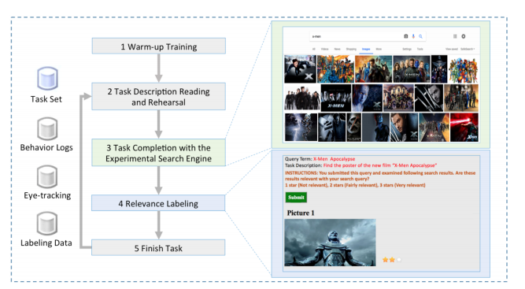
Research Approach: Lab-based User Study
A typical lab-based user study for IR:
Hiring participants to conduct a set of simulated search tasks in the lab
Collecting their search behavior in a lab-based environment
Pros:
Fully controlled, rich behavior measures
Cons:
Time-consuming
relatively restricted set of users

Slide 28
Research Approach: Crowdsourcing
Hiring participants from a crowdsourcing platform and conducting the user study remotely
e.g. Amazon Mechanical Turk
Pro:
Get a large amount of data in a much shorter time and at a much lower cost
Cons:
Less control of the study
The quality of collected data varies a lot, may have to filter some low quality datapoints
Zuccon, Guido, et al. "Crowdsourcing interactions: using crowdsourcing for evaluating interactive information retrieval systems." IRJ, 16.2 (2013): 267-305.

Slide 29
Research Approach: Field Study
Enrolling some participants but collecting their search behavior in which the search naturally occurs
Simulated search task in a lab environment vs real search task in daily life
Pros:
More naturalistic, the collected data are more representative of user’s true behavior
Cons:
More difficult to conduct
Privacy issues

Slide 30
Research Approach: Log-based Study
Logging real users’ search behavior on an operating system
Pros:
Easy to get a large number of user behavior log
Representative of user’s true behavior
Cons:
Hard to get explicit feedback from users
Privacy issue
Only available for companies

Slide 31
Observational Study vs Experiment
In an observational study，we do not intentionally manipulate the variables but try to identify the correlations between them
In an experiment, we manipulate some variables and observe their effects on other variable
Manipulated variables: independent variables
Observed variables: dependent variables
If we can successfully control the confounding effects, we can identify the causal effect of the independent variables upon the dependent variables
Kelly, Diane, and Anita Crescenzi. "From design to analysis: conducting controlled laboratory experiments with users.“ A tutorial at SIGIR 2016

Slide 32
Data collecting method：Survey
Useful for assessing and summarizing thoughts, opinions, and feelings of a group of people
Usually done by asking the participant to recall a recent search
For example, to understand users’ intent in product search we asked three open-ended questions in an online survey:
1. Please describe your latest product search experience with as many details as possible (target, motivation, time, place).
2. Please provide your queries. (You can view your search history to and all the queries used in this search.)
3. Please provide the name of the product you purchased (if any).
Su, Ning et al. “User Intent, Behaviour, and Perceived Satisfaction in Product Search.” WSDM 18

Slide 33
Data collecting method：Interview
Useful for having a more in-depth understanding of the experience of individual participant
Can be conducted after a user study to let the researcher have a comprehensive understanding of participants’ overall experience and whether there is any problem in the settings of the study
Both interview and survey contains open-ended questions, we may need to code the responses in free text into a set of concepts. For example, for the product search intent survey, we coded the responses with a schema consisting of three concepts:
Motivation: with/without a immediate purchase need
Target specificity
Search strategy

Slide 34
Data collecting method： Questionnaire and user feedback
Useful for measuring participants experience during the search (in a user study or field study)
Measures:
Satisfaction/Relevance/Usefulness/Task difficulty/Domain expertise/Mental effort/…
Scales of measures:
5 point or 7 point Likert scale
4 level relevance (not relevant/somewhat relevant/fairly relevant/highly relevant)

Slide 35
Data collecting method：Behavior Logging
Severside logging：
Query and clicked results
App downloads
Purchase
In a user study, if we don’t want to build a full-function search system, we can:
Use a proxy server to log all the HTTP requests
Build an experimental search portal which will crawl the results from another search engine in real time

Slide 36
Data collecting method：Behavior Logging
Clientside logging：
More fine-grained user behavior data including mouse move, hover, scrolling, touch gestures
Some clientside logging methods:
Use Javascript to log user behavior on a webpage
Implement a search app on smart phone
Implement a browser extension to log

Slide 37
Data collecting method：Behavior Logging
In-lab logging：
Eye-tracking
Physiological signal: heart rate, respiratory rate, skin conductance, muscle current,…
Brain Imaging: fMRI/EEG/ fNIRS
For example, Moshfeghi et al. used fMRI to investigate the emergence of information need
Moshfeghi, Yashar et al. “Understanding Information Need: an fMRI Study” SIGIR 16
Notes:
Eye-tracking: visual attention on the SERP and landing page
Physiological signal: experience and emotion during search
Brain Imaging: the cognitive process during search

Slide 38
Data collecting method：Annotation
Sometimes it is hard to get feedback from users, but we can ask human assessors to make some additional annotations:
Useful for evaluation
Relevance annotation for search results
Quality annotations for image search results
Usefulness annotation for search results if we give the assessors some search context information
Mao et al. “When does Relevance Mean Usefulness and User Satisfaction in Web Search?” SIGIR 16

Slide 39
Something you should consider
Reliability: if the results are replicable
statistical power for statistical analysis
Cronbach's alpha for the consistency of multiple measures
Cohen’s kappa for annotations
Validity: if the results show what you intended to show
E.g. whether a measure measures what you want it to measure
Whether the results of the study can generalize to the real world

Slide 40
Something you should consider
Privacy: a more and more important issue
For a user study, ask the participants for permissions to use the collected data and allow them to exit the study whenever they want
For a field study, allow the participants to remove the records they don’t want to share
For a log-based study, only collect and share the aggregated user behavior statistics but not any individual records
Ensure released user behavior data are differentially private

Slide 41
Wrap up
Collecting user behavior data is the first step in user behavior analysis and modeling
We can use different approaches and data collecting methods for building different kinds of models
When collecting user behavior data, you should think about its reliability, validity, and whether it has privacy issues

Slide 42
Q&A
Please raise your hands if you have any question
We will further revise our slides according to the Q&A

Slide 43
Analytical results of user behavior data
Xiaohui Xie

Slide 44
Analytical results of user behavior data
How do different search intents, relevance definition, result placement and interaction mechanism affect user behavior and satisfaction in vertical search scenarios ?

Slide 45
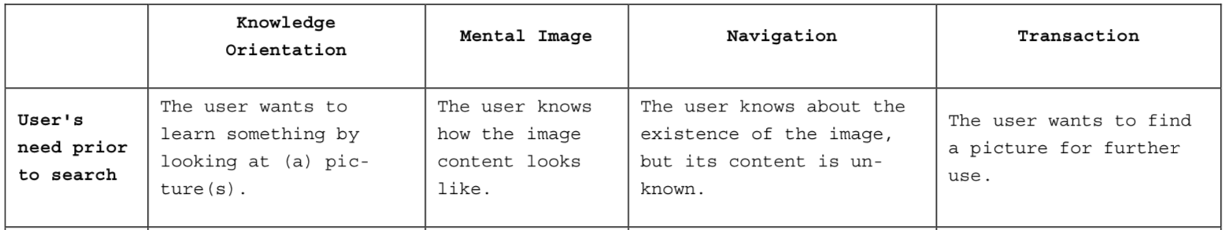
Search intents of image search
Image
Explore/Learn, Entertain and Locate/Acquire
Criterion 1: Is the user’s search behavior driven by a clear objective ?
Criterion 2: Does the user need to download the image for further use ?
Knowledge orientation, Mental image, Navigation, and Transaction
[1] Xiaohui Xie et al. “Why People Search for Images using Web Search Engines.” WSDM 2018
[2] Mathias Lux et al . “A Classification Scheme for User Intentions in Image Search” CHI 2010

Slide 46
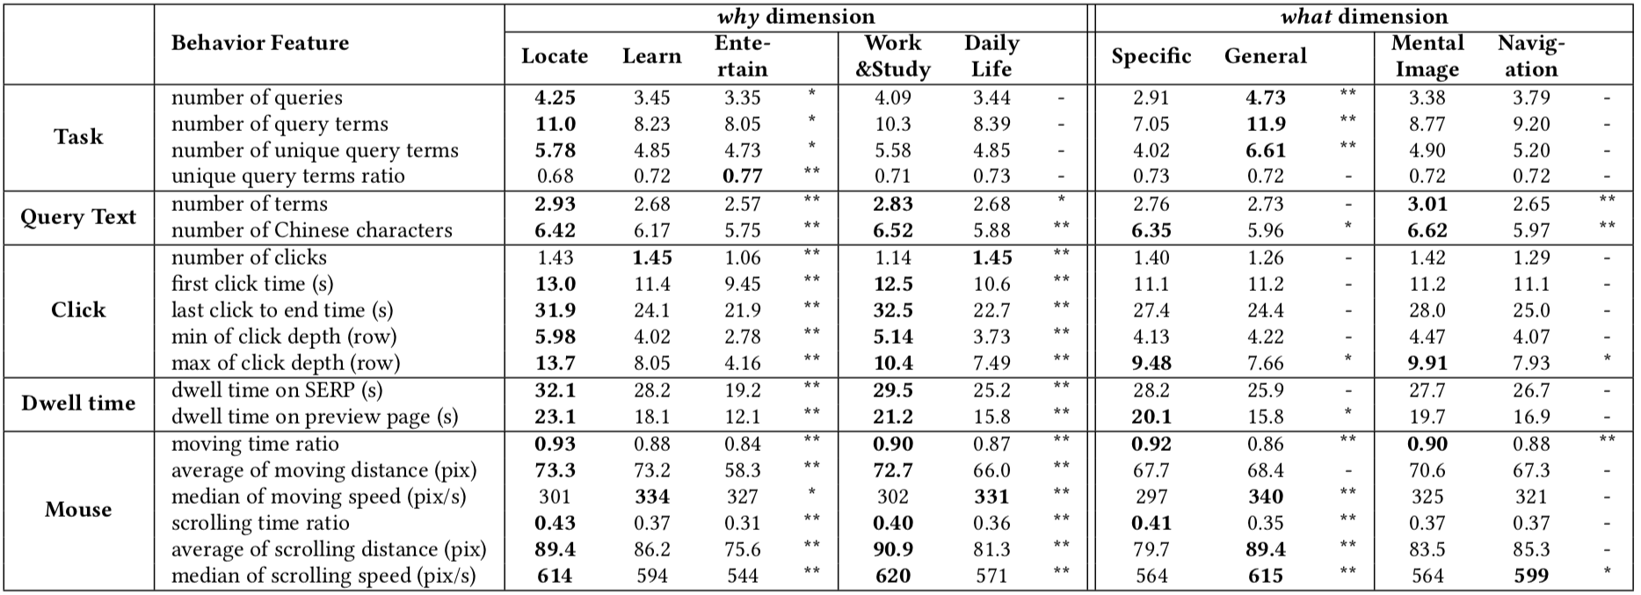
Search intents of image search
Image
User behavior data collected form a field study (one month)
Users with different intents behave differently
Zhijing Wu et al . “The Influence of Image Search Intents on User Behavior and Satisfaction” WSDM 2019

Slide 47
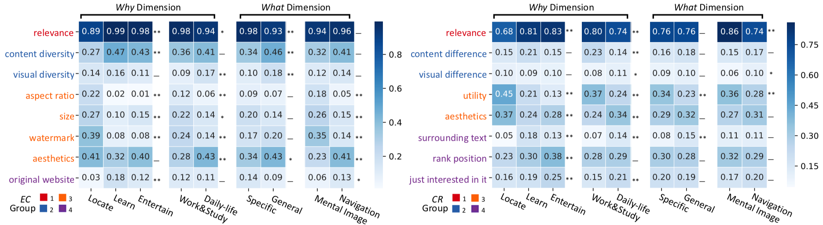
Search intents of image search
Image
Search intents affect evaluation criteria (EC) and reasons for click (CR)
Zhijing Wu et al . “The Influence of Image Search Intents on User Behavior and Satisfaction” WSDM 2019

Slide 48
Examination behavior of image search users
Image
Attention allocation mechanism on grid-based SERPs
Xiaohui Xie et al. “Investigating Examination Behavior of Image Search Users.” SIGIR 2017

Slide 49
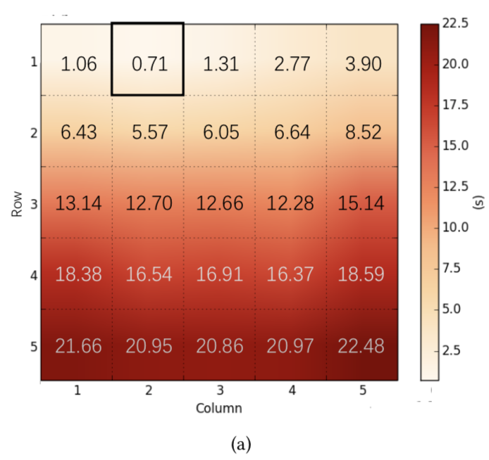
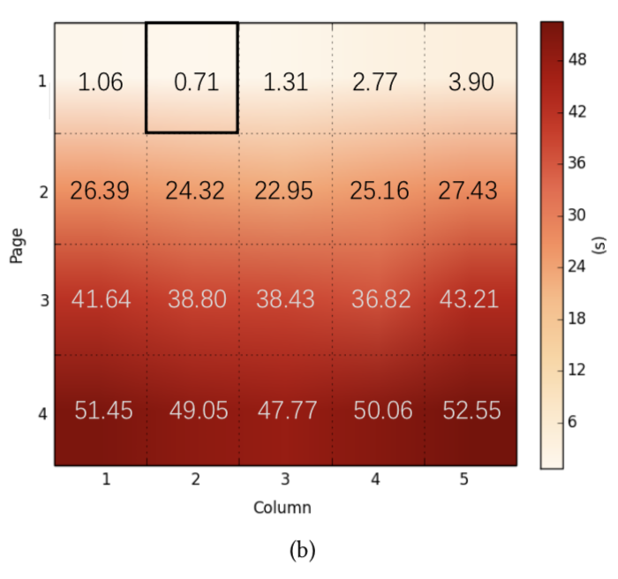
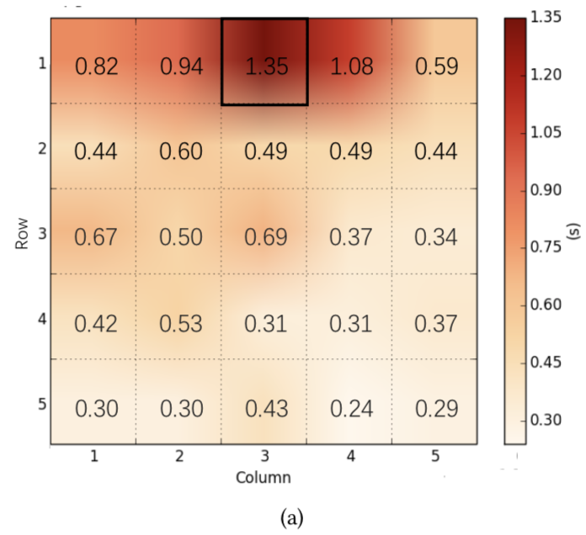
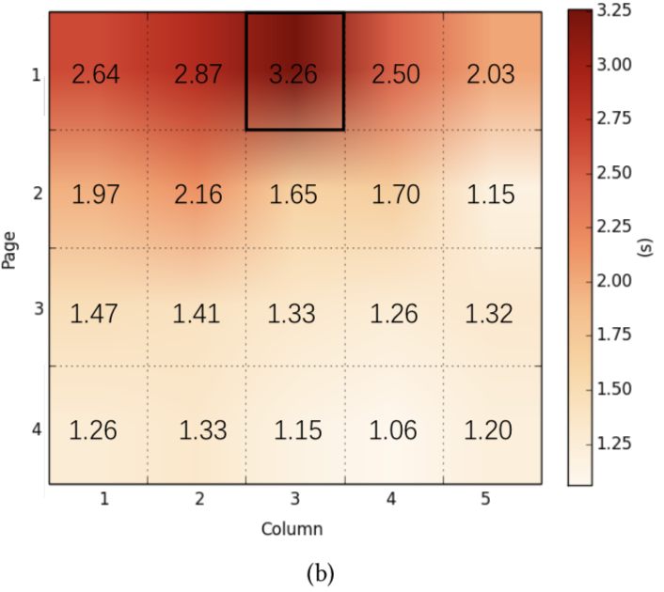
Examination behavior of image search users
Image
“F” shape (Golden triangle, general Web search) -> “T” shape (Web image search)
First arrival time & Examination duration
Middle position bias : Users pay more attention to the middle position than the leftmost or rightmost position
First arrival time
Examination duration
Xiaohui Xie et al. “Investigating Examination Behavior of Image Search Users.” SIGIR 2017

Slide 50
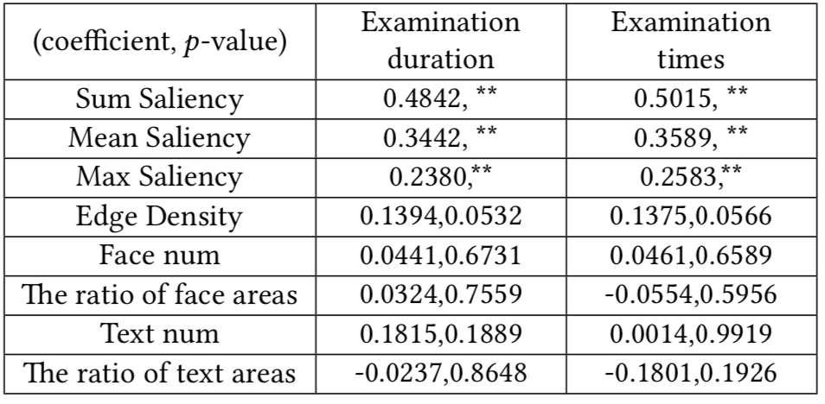
Examination behavior of image search users
Image
Nearby principle: Users prefer small amplitude and short distance transitions between images
Saliency has the highest correlation with fixation behavior in the sum, mean, and max of a given element, followed by the edge density feature
Xiaohui Xie et al. “Investigating Examination Behavior of Image Search Users.” SIGIR 2017

Slide 51
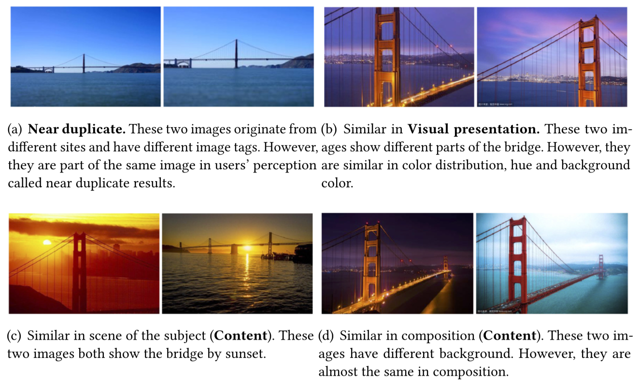
Diversity and user satisfaction
Image
Different types of diversity in the result of query “Golden Gate Bridge”
Zhijing Wu et al. “Does Diversity Affect User Satisfaction in Image Search.” TOIS 2019

Slide 52
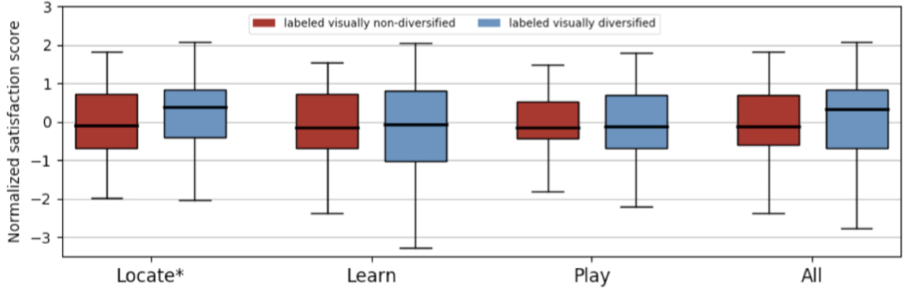
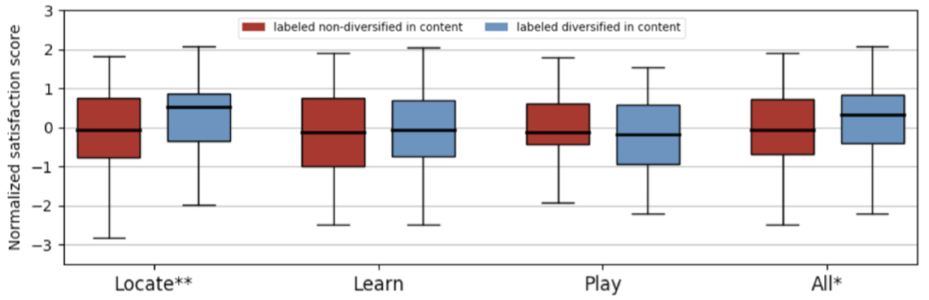
Diversity and user satisfaction
Image
Perceived visual diversity affects user satisfaction
Zhijing Wu et al. “Does Diversity Affect User Satisfaction in Image Search.” TOIS 2019

Slide 53
Search intents of product search
Product
Target Finding (TF), Decision Making (DM) and Exploration (EP)
TF -> EP: more explorative search strategies and less determined search target.
Shallow Exploration, Targeted Purchase, Major-Item Shopping, Minor-Item Shopping and Hard-Choice Shopping
Directed buying, Hedonic browsing, Search/deliberation, Knowledge building
 | Search behavior
Purchase Horizon | Direct | Exploratory
Immediate | Direct buying | Hedonic browsing
Future | Search/deliberation | Knowledge building
[1] Su, Ning et al. “User Intent, Behaviour, and Perceived Satisfaction in Product Search.” WSDM 18
[2] Sondhi, Parikshit et al. "A Taxonomy of Queries for E-commerce Search." SIGIR 2018
[3] Wendy W. Moe. “Buying, Searching, or Browsing: Differentiating Between Online Shoppers Using In-Store Navigational Clickstream” 2013

Slide 54
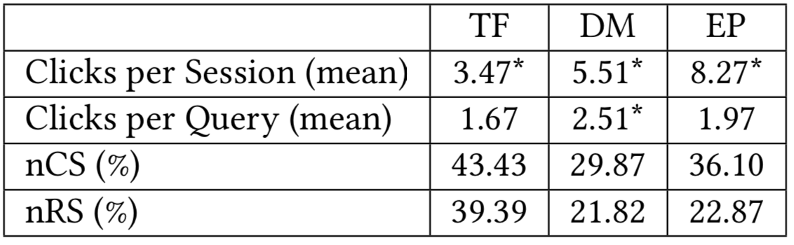
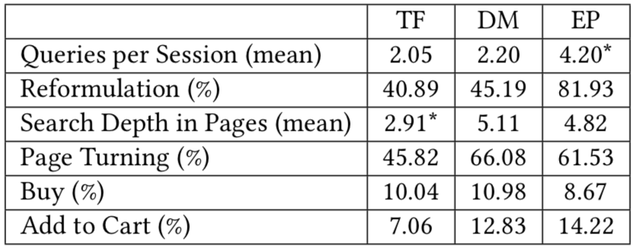
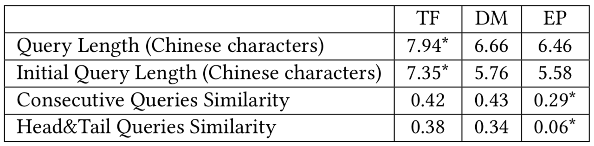
Search intents of product search
Product
Users with different intents behave differently
Taxonomy: Target Finding (TF), Decision Making (DM) and Exploration (EP)
Su, Ning et al. “User Intent, Behaviour, and Perceived Satisfaction in Product Search.” WSDM 18

Slide 55
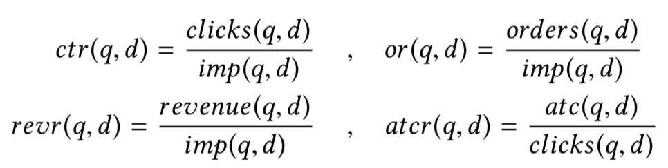
Relevance feedback signals
Product
Click through rate: Perceived utility of search results
Order rate: Overall user satisfaction
Revenue rate: Business value
Add-to-cart ratio: Perceived utility of the product page
Shubhra Kanti Karmaker Santu et al. “On Application of Learning to Rank for E-Commerce Search.” SIGIR 2017

Slide 56
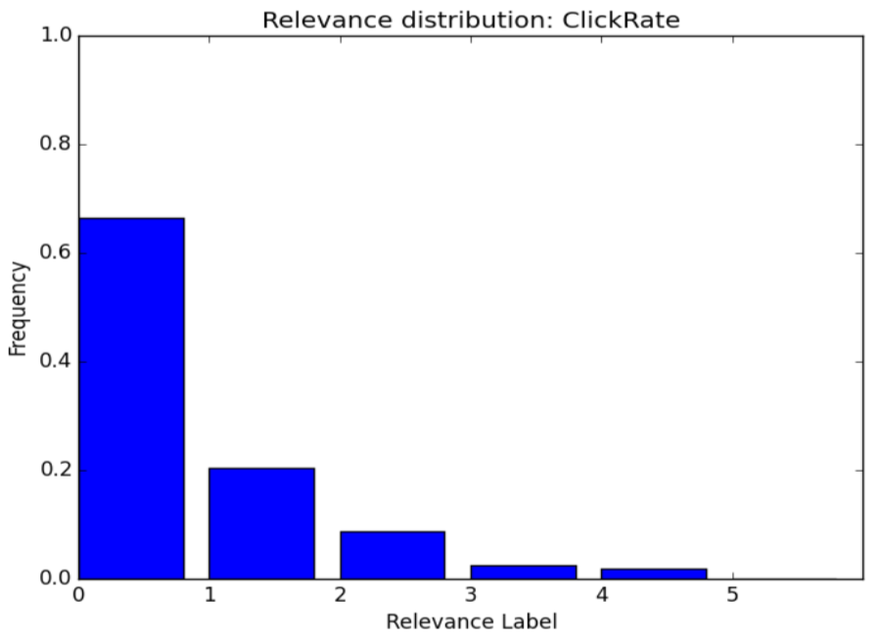
Relevance feedback signals
Product
Most queries have a small number of best selling products which dominate in terms of clicks, cart-adds, orders etc.
While some products tend to attract the most attention, there are indeed several products that users engage with and purchase.
Shubhra Kanti Karmaker Santu et al. “On Application of Learning to Rank for E-Commerce Search.” SIGIR 2017

Slide 57
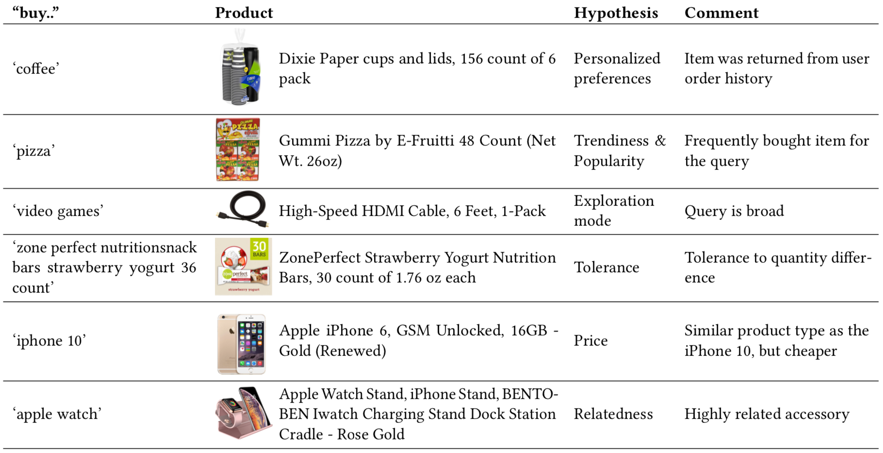
Relevance, purchase and engagement
Product
In a non-negligible number of cases, users who searched for products on headless devices significantly engage with irrelevant search results
David Carmel et al. “ Why Do People Buy Seemingly Irrelevant Items in Voice Product Search?”. WSDM 2020

Slide 58
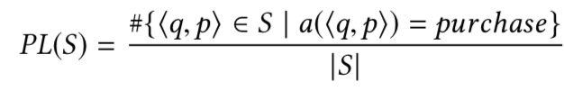
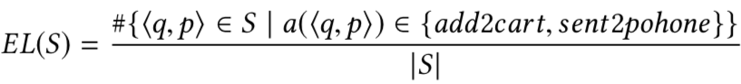
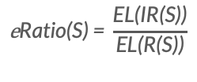
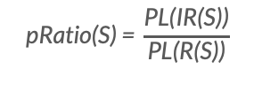
Relevance, purchase and engagement
Product
Customer actions : ignore, add2cart, send2phone, purchase
Purchase level (PL) and engagement level (EL)
Relevant (R(S)) & Irrelevant (IR(S))
P ratio and E ratio
$$\text{pRatio}\text{(}\text{S}\text{) = }\frac{\text{PL}\text{(}\text{IR}\text{(}\text{S}\text{))}}{\text{PL}\text{(}\text{R}\text{(}\text{S}\text{))}}$$
$$\text{e}\text{Ratio}\text{(}\text{S}\text{) = }\frac{\text{E}\text{L}\text{(}\text{IR}\text{(}\text{S}\text{))}}{\text{E}\text{L}\text{(}\text{R}\text{(}\text{S}\text{))}}$$
David Carmel et al. “ Why Do People Buy Seemingly Irrelevant Items in Voice Product Search?”. WSDM 2020

Slide 59
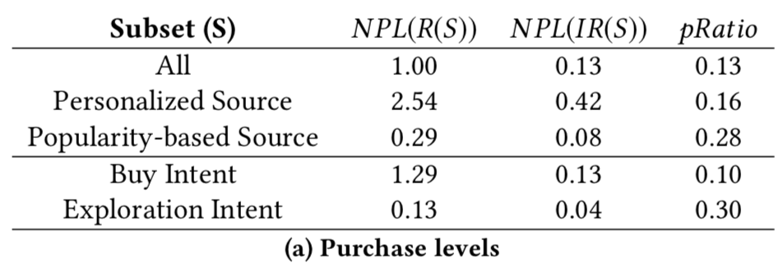
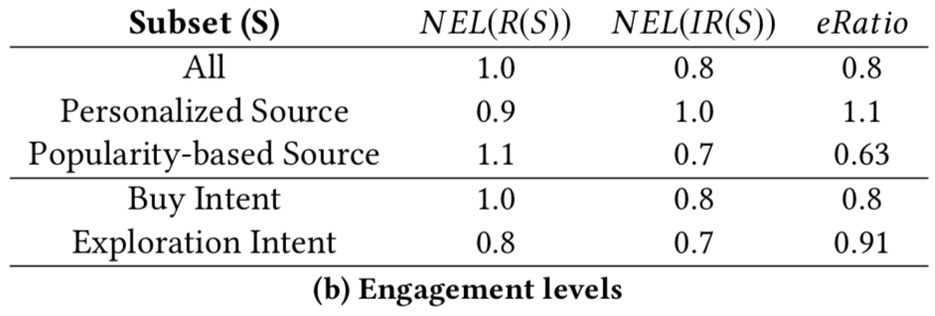
Relevance, purchase and engagement
Product
Personalized Preference & Product Popularity
David Carmel et al. “ Why Do People Buy Seemingly Irrelevant Items in Voice Product Search?”. WSDM 2020

Slide 60
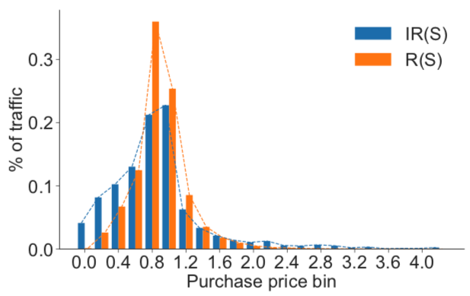
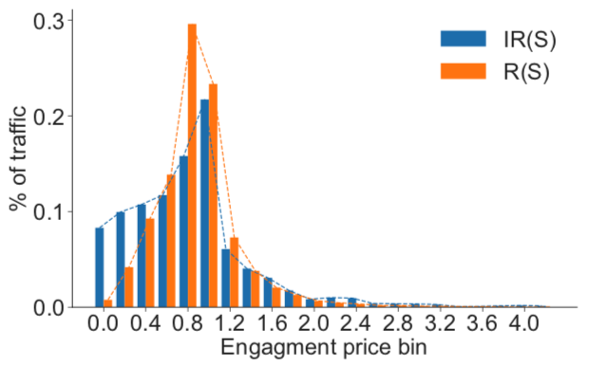
Relevance, purchase and engagement
Product
Product price
David Carmel et al. “ Why Do People Buy Seemingly Irrelevant Items in Voice Product Search?”. WSDM 2020

Slide 61
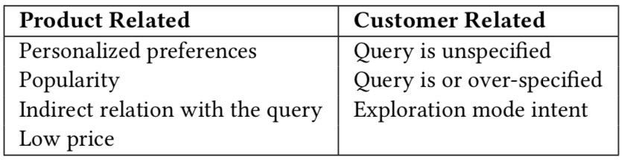
Relevance, purchase and engagement
Product
Some reasons for user engagement with seemingly irrelevant search results
David Carmel et al. “ Why Do People Buy Seemingly Irrelevant Items in Voice Product Search?”. WSDM 2020

Slide 62
Query reformulation and user behavior
Product
Session: Reformulation session, Non-reformulation session and Singleton session
Query types in an eBay session
Reformulation query
Fresh query & Final query
First query & Last query
Non-reformulation query
Singleton query
Reformulation-first query & Reformulation-last query
Click and purchase behavior
Sharon Hirsch et al. “Query Reformulation in E-Commerce Search.” SIGIR 2020

Slide 63
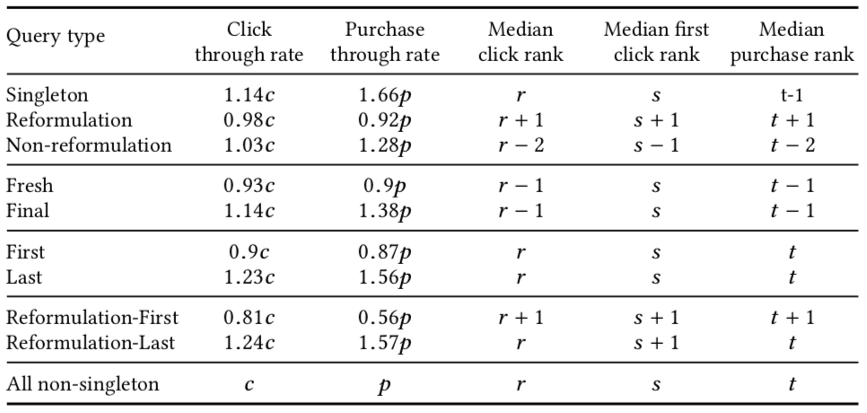
Query reformulation and user behavior
Product
Clicks and purchases for different types of queries
Sharon Hirsch et al. “Query Reformulation in E-Commerce Search.” SIGIR 2020

Slide 64
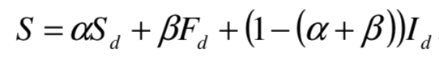
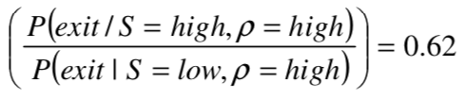
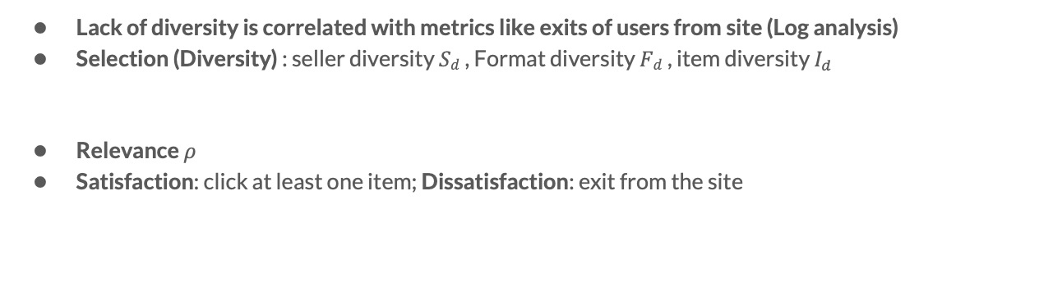
Diversity, relevance and user satisfaction
Product
Lack of diversity is correlated with metrics like exits of users from site (Log analysis)
Selection (Diversity) : seller diversity $Sd$, Format diversity $Fd$, item diversity $I_{d}$
Relevance $ρ$
Satisfaction: click at least one item; Dissatisfaction: exit from the site
Nish Parikh et al. “Beyond Relevance in Marketplace Search.” CIKM 11

Slide 65
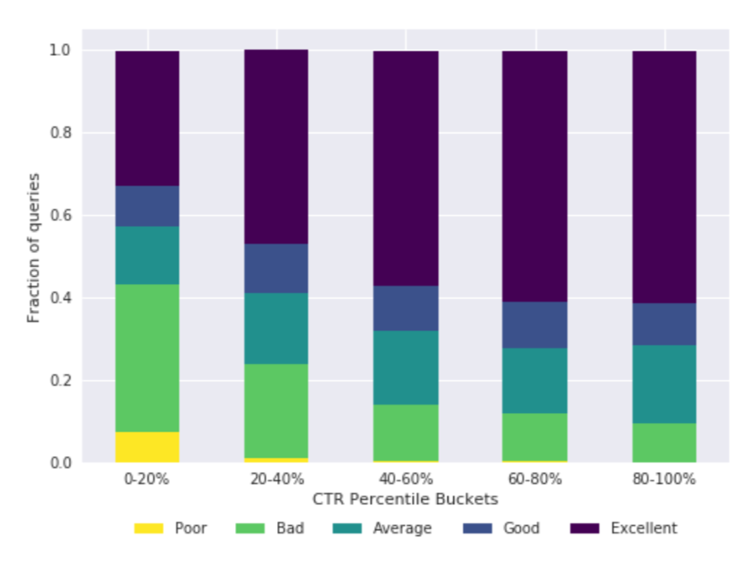
Predicting query performance
Product
Learning the quality of the results served by the search engine based on users’ interactions with the results
In e-commerce search, CTR can be misleading
Rohan Kumar et al. " Did We Get It Right? Predicting Query Performance in E-commerce Search ". SIGIR 2018

Slide 66
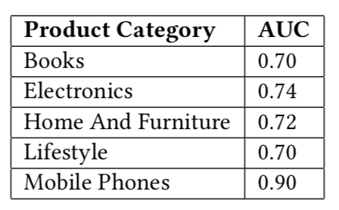
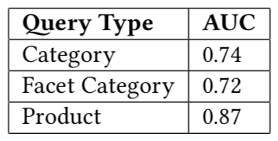
Predicting query performance
Product
User interaction signals, query information, meta aspects can be used to predict query performance (SAT or DSAT) -> AUC 0.75
Feature importance: (1) numSwipes (2) clickSuccess (3) queryType (4) wordQueryLen (5) numProductsFound (6) cartSuccess (7) numFilters (8) numClicks (9) numSorts (10) queryCount
Rohan Kumar et al. " Did We Get It Right? Predicting Query Performance in E-commerce Search ". SIGIR 2018

Slide 67
User habits in app search
Application
Two kinds of queries in app search
Precise Search: Search by app name, mostly prompted by the search box
Fuzzy Search:
Non-Name, always colloquial expression
Content/Category/Function related (e.g. music application, application that reminds time)
User-habit of web search is brought to app search on mobile
Juchao Zhuo et al. “Semantic Matching in App Search”. WSDM 2015

Slide 68
Future directions
Understanding of cognitive model of search users (Brain-machine interface)
Understanding user behavior of vertical search in more complex settings
Multimodal inputs e.g. voice and image
Long-term versus short-term search sessions
Delayed feedback loops

Slide 69
User-centric evaluation metrics
Xiaohui Xie

Slide 70
User-centric evaluation metrics
How can we use behavior data to design evaluation metrics to better reflect user satisfaction in the context of vertical search?

Slide 71
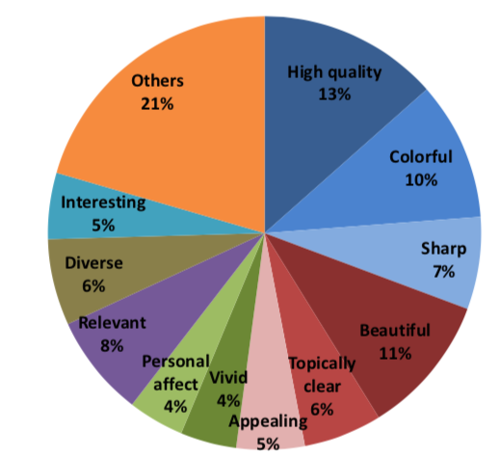
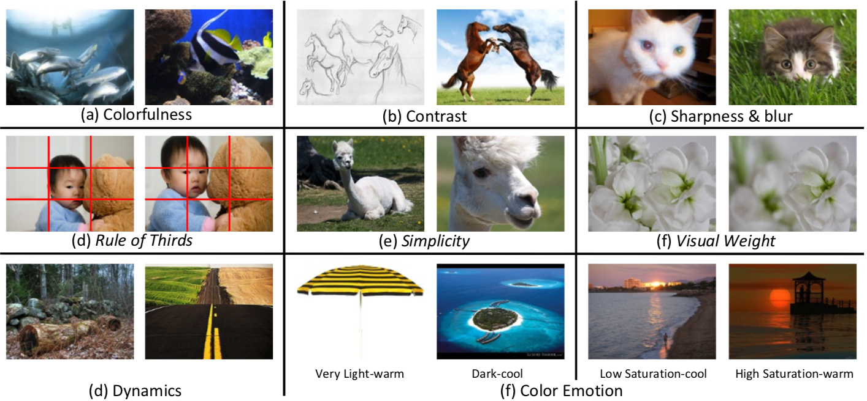
The role of image attractiveness
Image
Users generally pose a strong demand on the attractiveness of images
Bo Geng et al. “The Role of Attractiveness in Web Image Search”. MM 2011

Slide 72
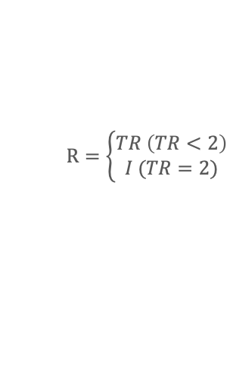
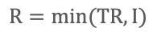
Relevance judgments in image search
Image
Topical relevance (3): Irrelevant (0), Fairly relevant (1), Highly relevant (2)
Image quality (5): Bad, Fair, Good, Professional, Exceptional
Combined relevance (R) : Topical relevance (TR) + Image quality (attractiveness) (I)
$$R=\left\{\begin{aligned}TR \left(TR<2\right) \\ I (TR=2)\end{aligned}\right.$$
$$R=min(TR, I)$$
[1] Neil O’Hare et al. “Leveraging User Interaction Signals for Web Image Search”. SIGIR 2016
[2] Fan Zhang et al. “How Well do Offline and Online Evaluation Metrics Measure User Satisfaction in Web Image Search?”. SIGIR 2018

Slide 73
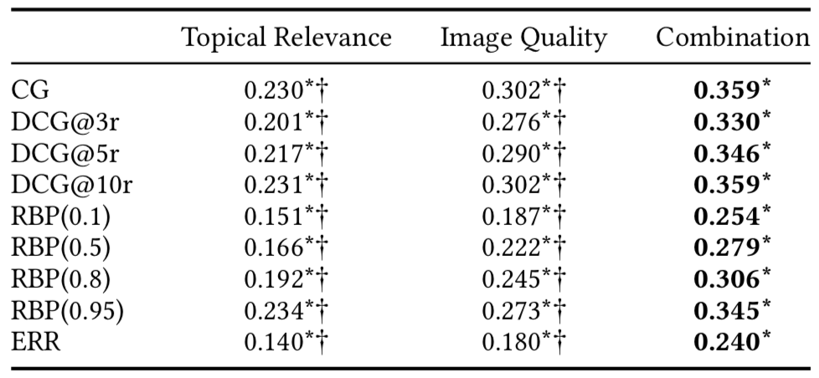

Offline vs Online evaluation metrics
Image
Offline Metrics based on combined relevance have much higher correlation than that based on solely topical relevance or image quality judgments
Considering gird-based information is beneficial for evaluation metrics
Fan Zhang et al. “How Well do Offline and Online Evaluation Metrics Measure User Satisfaction in Web Image Search?”. SIGIR 2018

Slide 74


Offline vs Online evaluation metrics
Image
Online evaluation metrics
Fan Zhang et al. “How Well do Offline and Online Evaluation Metrics Measure User Satisfaction in Web Image Search?”. SIGIR 2018

Slide 75


Offline vs Online evaluation metrics
Image
Offline vs Online evaluation metrics in different search intent scenarios
Fan Zhang et al. “How Well do Offline and Online Evaluation Metrics Measure User Satisfaction in Web Image Search?”. SIGIR 2018

Slide 76


Fine-grained relevance scale
Image
S100 Topical relevance vs. S4 Topical relevance
Combined relevance (CR), Topical relevance (TR), Image quality (IQ)
Yunqiu Shao et al. “On Annotation Methodologies for Image Search Evaluation”. TOIS 2019

Slide 77




Grid-based evaluation metrics
Image
Evaluation framework
RBP, DCG, ERR
$$C_{i}\left(RBP\right)= ρ$$
Xiaohui Xie et al. “Grid-based Evaluation Metrics for Web Image Search”. theWebConf 2019

Slide 78
Grid-based evaluation metrics
Image
Three major findings of user examination behavior on image SERPs
“Middle bias” : Image search results in the middle position may attract more attention from search users than results in the left-most or rightmost position.
“Slower decay”: Users’ attention does not decrease monotonically and dramatically with the rank position. In the case of image search attention decays at a slower speed than in general web search.
“Row skipping” : Users may ignore particular rows and directly jump to results at some distance.
Xiaohui Xie et al. “Grid-based Evaluation Metrics for Web Image Search”. theWebConf 2019

Slide 79




Grid-based evaluation metrics
Image
Middle position bias (MB)
Slower decay (SD)
Row skipping (RS)
Xiaohui Xie et al. “Grid-based Evaluation Metrics for Web Image Search”. theWebConf 2019

Slide 80


Grid-based evaluation metrics
Image
Better performance of behavior prediction & correlation with user satisfaction
Mean Log-likelihood of user behavior models
Pearson’s Correlation with user satisfaction
Xiaohui Xie et al. “Grid-based Evaluation Metrics for Web Image Search”. theWebConf 2019

Slide 81
Preference-based evaluation metrics
Image
Graded relevance judgments have a number of limitations
The lack of a universal interpretation of multi-valued relevance scales makes it hard to compare scales
It is difficult to define clear and sufficient grades of relevance in image search scenarios
Existing work shows that relevance-based evaluation metrics do not correlate well with user satisfaction in web image search
Xiaohui Xie et al. “Preference-based Evaluation Metrics for Web Image Search”. SIGIR 2020

Slide 82

Preference-based evaluation metrics
Image
Graded relevance judgments => Preference judgments
Weak preference vs Strict preference (“Tie” option is provided or not)
Xiaohui Xie et al. “Preference-based Evaluation Metrics for Web Image Search”. SIGIR 2020

Slide 83

Preference-based evaluation metrics
Image
Relation between graded relevance judgments and preference judgments
Xiaohui Xie et al. “Preference-based Evaluation Metrics for Web Image Search”. SIGIR 2020

Slide 84
Preference-based evaluation metrics
Image
Preference Matching Rate (PMR)
The proportion of pairs that are correctly ordered by the system
Winning rate (WR)
The performance of a search system in terms of retrieving more images with high quality compared against another search engine
Penalty for bad cases (PB)
PB is used to refine preference towards a search system retrieving “bad case”
Preference-Winning-Penalty (PWP)
Xiaohui Xie et al. “Preference-based Evaluation Metrics for Web Image Search”. SIGIR 2020

Slide 85

Preference-based evaluation metrics
Image
Preference-based evaluation metrics outperforms existing relevance-based metrics in terms of correlation to SERP-level preferences
Xiaohui Xie et al. “Preference-based Evaluation Metrics for Web Image Search”. SIGIR 2020

Slide 86
Evaluation metrics for product search
Product
Signals: click, purchase, revenue
MAP
MRR
NDCG@K
HIT@K

Slide 87

Revenue @ K
Product
Assumption: An item that has been actually purchased, will also be purchased under the new ranking order if it is shown in the top K positions
Liang Wu et al. “ Turning Clicks into Purchases: Revenue Optimization for Product Search in E-Commerce ”. SIGIR 2018

Slide 88
App search metrics
Application
Downloads / QV(Query views) / UV(User views)
CTR(Click-Through-Rate) / ROP(Rate of Penetration)
NDCG (Normalized Discounted Cumulative Gain)
Juchao Zhuo et al. “Semantic Matching in App Search”. WSDM 2015

Slide 89
Future directions
Performance versus Annotation cost
Evaluation on the basis of multidimensional relevance (Beyond topical relevance)
Evaluation of personalized ranking
Evaluation of multi-queries search sessions

Slide 90
User-centric ranking models
Maarten de Rijke

Slide 91
User-centric ranking models
How can we use behavior data to construct better ranking models to improve the performance of vertical search engines?
Learning to rank models on the basis of user behavior features
User interaction models (e.g. click models)
Deep models utilizing user behavior and content information

Slide 92
LETOR with implicit feedback
Image
User behavior features
Click through rate, Hover through rate, Converted hover rate, Dwell time etc.
Three levels of propagation for the user behavior features
Q-URL. The query is associated with the image URL for the clicked/viewed image
Q-Refpage. The query is associated with the URL of the referral page where the image is embedded.
Q-Independent. The features are calculated for the image url, independently of the query.
Baselines: B1 (purely content-based), B2 (B1 + CTR for Q-URL)
LETOR model: GBRank model
Neil O’Hare et al. “Leveraging User Interaction Signals for Web Image Search”. SIGIR 2016

Slide 93

LETOR with implicit feedback
Image
Relevance + Quality NDCG Results for Image Search with Implicit Feedback features
Neil O’Hare et al. “Leveraging User Interaction Signals for Web Image Search”. SIGIR 2016

Slide 94


Grid-based user browsing model (GUBM)
Image
Assumption 1 – Examination hypothesis in image search
An image result being interacted with ($I_{i} = 1$) accords with two independent conditions: it is examined ($E_{i}=1$) and it is relevant ($R_{i} = 1$)
Xiaohui Xie et al. “Constructing an Interaction Behavior Model for Web Image Search”. SIGIR 2018

Slide 95


Grid-based user browsing model (GUBM)
Image
Assumption 2 – Locally unidirectional examination assumption
Between adjacent interaction signals, users tend to examine results in one direction without changes both in the vertical direction and in the same row. And the vertical examination direction is consistent with the vertical interaction direction.
Vertical direction
Horizontal direction
Xiaohui Xie et al. “Constructing an Interaction Behavior Model for Web Image Search”. SIGIR 2018

Slide 96


Grid-based user browsing model (GUBM)
Image
Assumption 3 – Non one-by-one examination assumption
When users examine the results between two adjacent interaction signals, they will skip several results and examine a result at some distance.
Xiaohui Xie et al. “Constructing an Interaction Behavior Model for Web Image Search”. SIGIR 2018

Slide 97


Grid-based user browsing model (GUBM)
Image
Left :A simulation of examination behavior on image SERP
Right : Graphical representation of grid-based user browsing model (GUBM)
Xiaohui Xie et al. “Constructing an Interaction Behavior Model for Web Image Search”. SIGIR 2018

Slide 98


Grid-based user browsing model (GUBM)
Image
GUBM achieves better performance in terms of relevance (Topical relevance (TR) + Image quality(I)) estimation
Xiaohui Xie et al. “Constructing an Interaction Behavior Model for Web Image Search”. SIGIR 2018

Slide 99

Context-aware re-ranking model (CARM)
Image
User preferences encoded in the past history (i.e., contextual information) have been shown to be valuable for search result re-ranking
Xiaohui Xie et al. “Improving Web Image Search with Contextual Information”. CIKM 2019

Slide 100

Context-aware re-ranking model (CARM)
Image
CARM: a hybrid encoder with an attention mechanism to model intra-query and inter-query user preferences for image results in a two-stage structure
Xiaohui Xie et al. “Improving Web Image Search with Contextual Information”. CIKM 2019

Slide 101

Context-aware re-ranking model (CARM)
Image
CARM can better model contextual information
Xiaohui Xie et al. “Improving Web Image Search with Contextual Information”. CIKM 2019

Slide 102



Context-aware re-ranking model (CARM)
Image
CARM can improve the original ranking in terms of personalized ranking and relevance ranking (CARM + OR : ${S= λS}_{c}+(1−λ)S_{o}$)
Xiaohui Xie et al. “Improving Web Image Search with Contextual Information”. CIKM 2019

Slide 103

Two stages of a product search session
Product
Stage 1: Clicking (ranking); Stage 2: Purchasing (Classification)
Liang Wu et al. “ Turning Clicks into Purchases: Revenue Optimization for Product Search in E-Commerce ”. SIGIR 2018

Slide 104



LETOR with implicit feedback
Product
LETORIF (implicit feedback) holistically model the interdependence of the two stages
Optimize click (ranking)
Optimize purchase (classification)
Liang Wu et al. “ Turning Clicks into Purchases: Revenue Optimization for Product Search in E-Commerce ”. SIGIR 2018

Slide 105

LETOR with implicit feedback
Product
LETORIF achieves the best Purchase NDCG and Revenue NDCG
Liang Wu et al. “ Turning Clicks into Purchases: Revenue Optimization for Product Search in E-Commerce ”. SIGIR 2018

Slide 106


Learning latent vector spaces for products
Product
Latent vector space model that jointly learns latent representations of words, products, and mapping between the two
Learns relationship directly using gradient descent, using noise-contrastive estimation
Christophe Van Gysel et al. " Learning Latent Vector Spaces for Product Search". CIKM 2016

Slide 107


Hierarchical embedding model (HEM)
Product
Personal preferences often have an important influence on the purchase decision
Review history => User preference
Qingyao Ai et al. " Learning a Hierarchical Embedding Model for Personalized Product Search ". CIKM 2019

Slide 108

TranSearch model
Product
Visual preference is important for product search
also_view and buy_after_viewing behavior can be used to learn feature spaces for visual and textual modalities.
Pre-trained model
Yangyang Guo et al. " Multi-modal Preference Modeling for Product Search ". MM 2018

Slide 109

TranSearch model
Product
TranSearch model learns user preference representation, query representation, and product representation based on a learning-to-rank framework
Yangyang Guo et al. " Multi-modal Preference Modeling for Product Search ". MM 2018

Slide 110

TranSearch Model
Product
Incorporating the visual modality of products can boost the product search performance
Yangyang Guo et al. " Multi-modal Preference Modeling for Product Search ". MM 2018

Slide 111

Zero attention model (ZAM)
Product
The potential of personalization depends on query characteristics, interactions between queries, and user purchase histories
Purchase history
Qingyao Ai et al. "A Zero Attention Model for Personalized Product Search". CIKM 2019

Slide 112
Zero attention model (ZAM)
Product
A Zero Attention Strategy that relaxes the constraints of existing attention mechanisms by introducing a Zero Vector in the attention process
Qingyao Ai et al. "A Zero Attention Model for Personalized Product Search". CIKM 2019

Slide 113

Zero attention model (ZAM)
Product
Considering query-dependent user profiling is beneficial
QEM: Non personalized model
Qingyao Ai et al. "A Zero Attention Model for Personalized Product Search". CIKM 2019

Slide 114

Using less noisy behavioral signals
Product
If interaction signals other than clicks are available, use them
AtB (“add to basket”), orders
Counterfactual risk minimization approach using logged AtB and/or order data
Needs logged contexts (query+product description), actions, probability of action, and feedback
Use a CNN-based model for Pointwise LTR, with SNIPS, using AtB clicks
Muhammad Umer Anwaar et al. “Mend The Learning Approach, Not the Data: Insights for Ranking E-Commerce Products”. ECML-PKDD 2020

Slide 115

Semantic matching with tag
Application
Tag extraction from web data
Tag from question-answering
Tag from user behavior logs
Users Profile
gender, age, location, ...
Users Behavior
search, download, install, ...
Juchao Zhuo et al. “Semantic Matching in App Search”. WSDM 2015

Slide 116

Semantic matching with tag
Application
Online A/B test measurement: CTR promoted by 6%~8%
Juchao Zhuo et al. “Semantic Matching in App Search”. WSDM 2015

Slide 117
Future directions
Making effective use of the broad diversity of feedback signals with widely differing timescales
Bring in more behavioral aspects, e.g., repeat behavior (of interest, of consumption, etc.)
Bring in task understanding as a way of enriching our modeling of user behavior
Tradeoff between personalization and privacy
Interpretability of result ranking

Slide 118
Wrap up and Future directions
Maarten de Rijke

Slide 119
Wrap up
Vertical search is different from general web search on search intents, relevance definitions, result placement and interaction mechanisms
We show how to collect and mine user behavior data through lab-based user study, field study and search log given a search scenario
User behavior in vertical search varies with different search intents, relevance definitions, result placement and interaction mechanisms
User behavior can be used to design better evaluation metrics in terms of correlation to user satisfaction and preference
User behavior can be used to construct better ranking models to improve the performance of vertical search engines

Slide 120
Future directions
Deeper understanding of user behavior
Understanding of cognitive model of search users (Brain-machine interface)
Understanding user behavior of vertical search in more complex settings
Better user-centric evaluation metrics
Performance versus Annotation cost
Evaluation on the basis of multidimensional relevance (Beyond topical relevance)
Evaluation of personalized ranking and multi-queries search sessions
Better user-centric ranking models
Making effective use of the broad diversity of feedback signals with widely differing timescales
Tradeoff between personalization and privacy
Interpretability of result ranking

Slide 121
Supporting materials
Slides.
[somewhat later] Pointers to protocols (processes and settings) to conduct field study, user study to collect and mine user behavior data.
[somewhat later] Pointers to code and data samples to follow experimental segments of the tutorial.
[even later] Extensive annotated bibliography.
These materials will be made available at https://github.com/THU xiexiaohui/SIGIR-2020-Tutorial

